Slide 1

Oracle 12c: SQL
Chapter 3
Table Creation and Management
©2016. Cengage Learning. All rights reserved.

Slide 2
Objectives
Identify the table name and structure
Create a new table using the CREATE TABLE command
Use a subquery to create a new table
Add a column to an existing table
Modify the definition of a column in an existing table
Delete a column from an existing table
©2016. Cengage Learning. All rights reserved.

Slide 3
Objectives (continued)
Mark a column as unused and then delete it at a later time
Rename a table
Truncate a table
Drop a table
©2016. Cengage Learning. All rights reserved.

Slide 4
Defining Oracle 12c Database Tables
Tables
  Primary data objects in relational database
Constraints
  Restrictions on data values that column can store
Oracle naming standard
  Rules that Oracle corporation has established for naming all database objects
Notes:
When you create a new table, you specify the table name, the name of each data column, and the data type and size of each data column, and constraints.

Slide 5
Database Table
A database object
Stores data for the database
Consists of columns and rows
Created and modified through data definition language (DDL) commands
©2016. Cengage Learning. All rights reserved.

Slide 6
Table Design
Table and column names:
  Can contain a maximum 30 characters – no blank spaces
  Must begin with a letter
  Can contain numbers, underscore (_), and number sign (#)
  Must be unique
  No reserved words are allowed
©2016. Cengage Learning. All rights reserved.

Slide 7
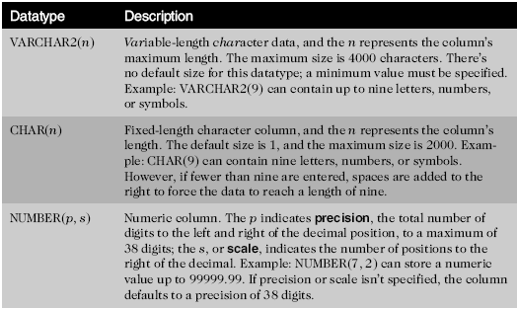
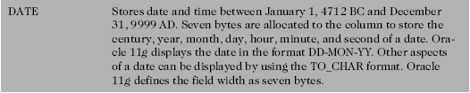
Table Design (continued)
©2016. Cengage Learning. All rights reserved.

Slide 8
Character Data Types
Oracle 12c stores data in VARCHAR2 and CHAR2 columns using American Standard Code for Information Interchange (ASCII)
  ASCII represents each character as an 8-digit (one-byte) binary value with the total of 256 different characters
  VARCHAR2 and CHAR2 are used to represent standard English character set
Unicode is a standardized technique that provides way to encode data in diverse languages
  NVARCHAR2 and NCHAR are counterpart of VARCHAR2 and CHAR2
  NVARCHAR2 and NCHAR use Unicode coding
Oracle 11g: SQL
Notes:
Examples of other character sets are Kanji, which represents the Japanese language, and Cyrillic, which represents Russian and a variety of eastern European languages.

Slide 9
Number Data Types
Integer number syntax
  columnname NUMBER(precision)
Fixed-point number
  Contains specific number of decimal places
  Column declaration specifies both precision and scale
  Example:
    prod_price NUMBER(5, 2)
Floating-point number
  Contains variable number of decimal places
  Syntax:
    columnname NUMBER
  Example:
    s_gpa NUMBER
Oracle 11g: SQL
Notes:
For an integer data column, if the user enters a value that contains digits to the right of the decimal point, the DBMS rounds the value to the nearest whole number.

Slide 10
Date And Time Data Types
Oracle default date format
  DD-MON-YY
  Example: 07-JAN-10
Oracle default time format
  HH:MI:SS AM
  Example: 12:00:00 AM
  Dates can be displayed in other formats using the TO_CHAR function
Oracle 11g: SQL

Slide 11
Extended Data Types
Introduced in Oracle 12c:
  Enables storage of additional data bytes in specific data types
  Database parameters must be enabled by an Oracle system administrator
©2016. Cengage Learning. All rights reserved.

Slide 12

Table Creation
©2016. Cengage Learning. All rights reserved.

Slide 13
Defining Columns
Column definition list must be enclosed in parentheses
Datatype must be specified for each column
Maximum of 1,000 columns
©2016. Cengage Learning. All rights reserved.

Slide 14
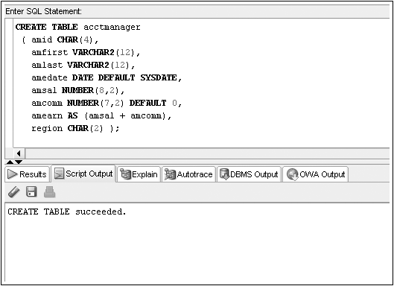
CREATE TABLE Command Example
Virtual Column
©2016. Cengage Learning. All rights reserved.

Slide 15
Data Dictionary
Oracle data dictionary
  Consists of tables that contain information about structure of database
  When a new database is created, the system creates the data dictionary in a user schema named SYS
  Users do not directly manipulate with the data dictionary tables
  Users interact with the database through views

Slide 16
Data Dictionary Views
View
  Database object DBMS bases on an actual database table
  Enables DBMS to present table data in different format based on needs of users
Data dictionary views categories
  USER: shows the objects in the current user’s schema
  ALL: shows the objects in the current user’s schema and the objects the user has privileges to manipulate
  DBA: allows DBAs to view information about all database objects
Oracle 11g: SQL

Slide 17
Viewing List of Tables: USER_TABLES
A data dictionary is a typical component of a DBMS that maintains information about database objects
You can query the data dictionary to verify all the tables that exist in your schema
The USER_TABLES data dictionary object maintains information regarding all your tables
©2016. Cengage Learning. All rights reserved.

Slide 18
Viewing Information about Tables (cont.)
Example:
  select table_name from user_tables;
Syntax
  SELECT view_columnname1, view_columnname2 … FROM prefix_object;
  where
  view_columnname1, view_columnname2 are names of the columns in the view you wish to retrieve
  prefix is the view category (USER, ALL, DBA)
  Object is the type of the database object you are examining (TABLES, CONSTRAINTS, etc.)
Oracle 11g: SQL

Slide 19
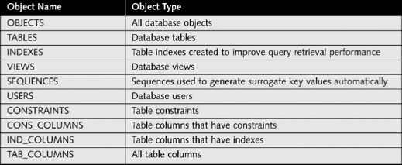
Database Objects with Data Dictionary Views
Oracle 11g: SQL

Slide 20
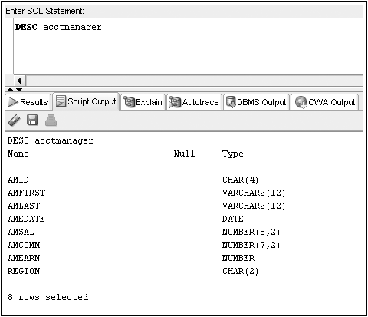
Viewing Table Structures: DESCRIBE
DESCRIBE displays the structure of a specified table
©2016. Cengage Learning. All rights reserved.

Slide 21
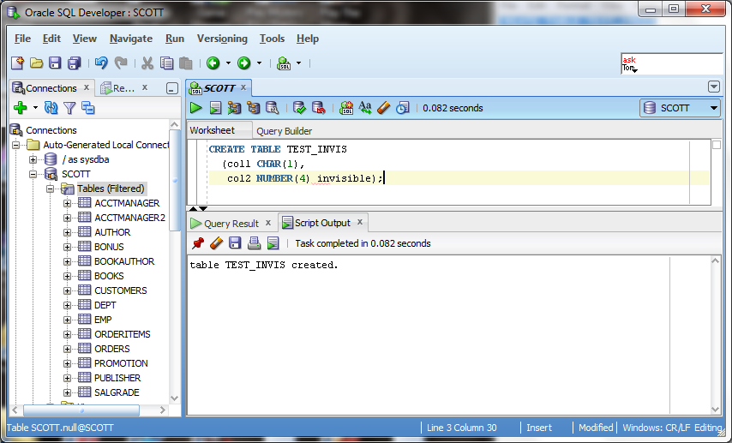
Invisible Columns
Oracle 12c allows hidden columns
©2016. Cengage Learning. All rights reserved.

Slide 22
Table Creation through Subqueries
You can use subqueries to retrieve data from an existing table
Requires use of AS keyword
New column names can be assigned
©2016. Cengage Learning. All rights reserved.

Slide 23
CREATE TABLE…AS
©2016. Cengage Learning. All rights reserved.

Slide 24
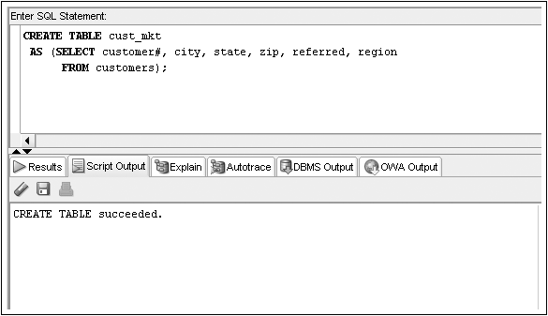
CREATE TABLE…AS Command Example
©2016. Cengage Learning. All rights reserved.

Slide 25
Modifying Existing Tables
Accomplished through the ALTER TABLE command
Use an ADD clause to add a column
Use a MODIFY clause to change a column
Use a DROP COLUMN to drop a column
©2016. Cengage Learning. All rights reserved.

Slide 26
ALTER TABLE Command Syntax
©2016. Cengage Learning. All rights reserved.

Slide 27
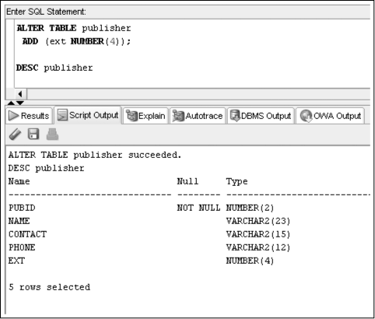
ALTER TABLE…ADD Command
©2016. Cengage Learning. All rights reserved.

Slide 28
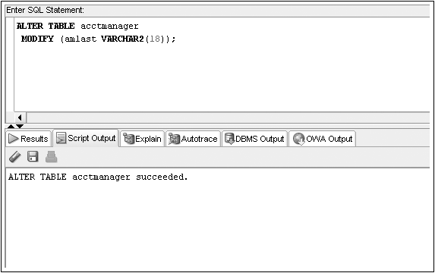
ALTER TABLE…MODIFY Command
©2016. Cengage Learning. All rights reserved.

Slide 29
Modification Guidelines
Column must be as wide as the data it already contains
If a NUMBER column already contains data, size cannot be decreased
Adding or changing default data does not affect existing data
©2016. Cengage Learning. All rights reserved.

Slide 30
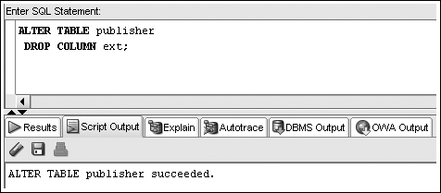
ALTER TABLE…DROP COLUMN Command
Can only reference one column per execution
Deletion is permanent
Cannot delete last remaining column in a table
©2016. Cengage Learning. All rights reserved.

Slide 31
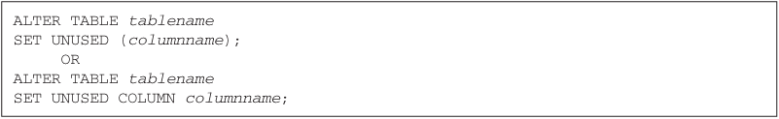
ALTER TABLE…SET UNUSED Command
Once marked for deletion, a column cannot be restored
Storage space is freed at a later time
©2016. Cengage Learning. All rights reserved.

Slide 32
ALTER TABLE…DROP UNUSED Command
Frees up storage space from columns previously marked as unused
©2016. Cengage Learning. All rights reserved.

Slide 33
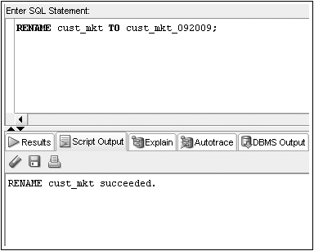
Renaming a Table
RENAME…TO is used to rename a table – the old name is no longer valid
©2016. Cengage Learning. All rights reserved.

Slide 34
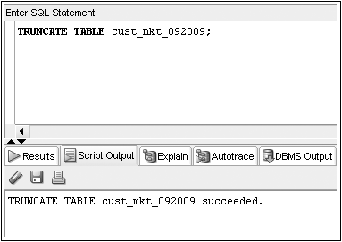
Truncating a Table
TRUNCATE TABLE command – rows are deleted
Structure of table remains
©2016. Cengage Learning. All rights reserved.

Slide 35
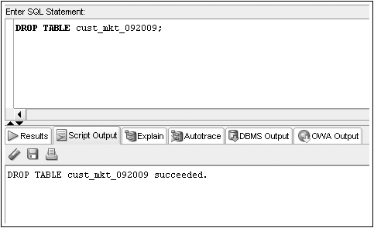
Deleting a Table
DROP TABLE command – table structure and contents are deleted
©2016. Cengage Learning. All rights reserved.

Slide 36
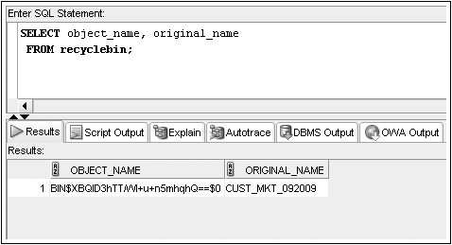
DROP TABLE without
Purge Option
Oracle 10g introduced a recycle bin
Dropped tables can be recovered from the recycle bin
©2016. Cengage Learning. All rights reserved.

Slide 37
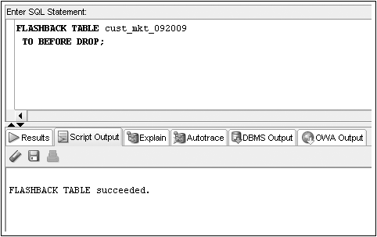
FLASHBACK Command
The FLASHBACK command recovers a table from the recycle bin
©2016. Cengage Learning. All rights reserved.

Slide 38
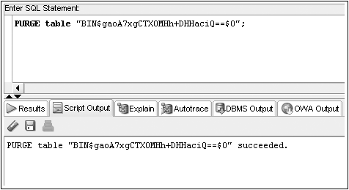
Use PURGE to Remove a Table from the Recycle Bin
©2016. Cengage Learning. All rights reserved.

Slide 39

PURGE Option Available for
DROP TABLE Command
Using the PURGE option will permanently remove a table from the database
The table will not be copied into the recycle bin
©2016. Cengage Learning. All rights reserved.

Slide 40
Summary
You create a table with the CREATE TABLE command
Each column to be contained in the table must be defined in terms of the column name, data type, and for certain data types, the width
A table can contain up to 1000 columns
Each column name within a table must be unique
You can change the structure of a table with the ALTER TABLE command
Columns can be added, resized, and even deleted with the ALTER TABLE command
Tables can be renamed with the RENAME...TO command
©2016. Cengage Learning. All rights reserved.

Slide 41
Summary (continued)
To delete all the rows in a table, use the TRUNCATE TABLE command
To remove both the structure of a table and all its contents, use the DROP TABLE command
A dropped table is moved to the recycle bin and can be recovered using the FLASHBACK TABLE command
Using the PURGE option in a DROP TABLE command permanently removes the table, meaning you cannot recover it from the recycle bin
©2016. Cengage Learning. All rights reserved.

